Slide 1
Mash atmS
ATM Services

Slide 2
Agenda
Introduction
Dataset Overview
Dataset Preparation
Data Analysis
Data Visualization
Strategic Insights & Actionable Recommendations

Slide 3
introduction
The analysis uncovers key trends, insights, and strategies to enhance operations and improve outcomes. Using tools like Python, Tableau, and SQL Server, it transforms raw data into actionable findings to address inefficiencies, improve customer satisfaction, and identify growth opportunities.

Slide 4
Source – size – relevant field
Dataset

Slide 5
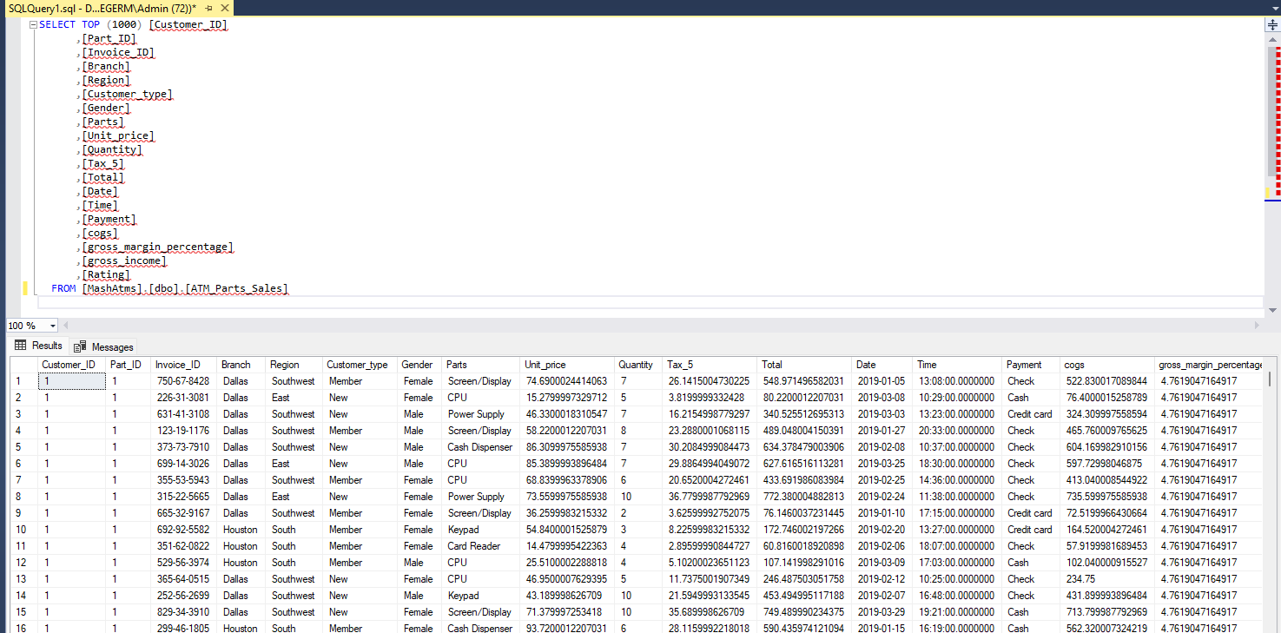

source
The data belongs to the company.
Company policy prohibits sharing company data.

Slide 6
size
Combined 3 datasets covering the last 5 years
ATM Parts Sales (6 GB)
Customers (2 GB)
Parts (5 GB)
Sample Group
Randomly sampled 40% of the data from each year

Slide 7
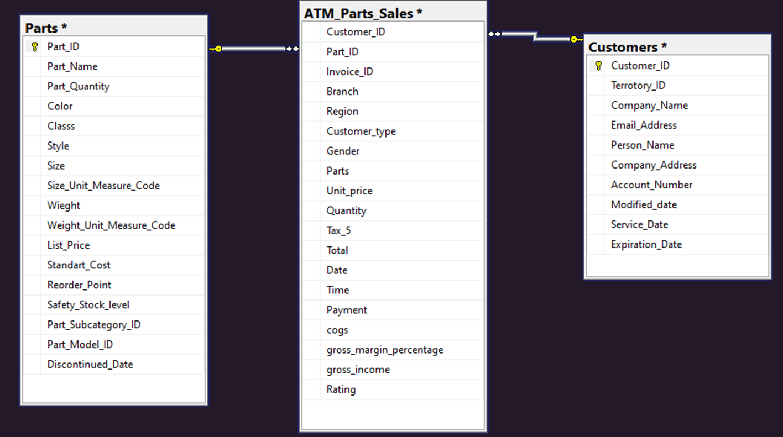
Relevant fields

Slide 8
languages - LIBRARIES - INFRASTRUCTURE
TOOLS

Slide 9
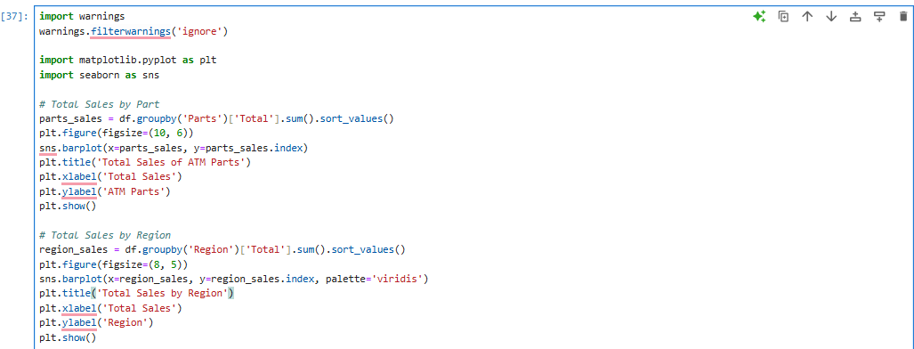
tools
Python
Pandas
Numpy
Matplotlib
Seaborn
SSIS
ETL
SSMS
Database Management
Tableau
Data Visualization

Slide 10
Data Cleaning and Preprocessing
Data Analysis & Feature Design

Slide 11
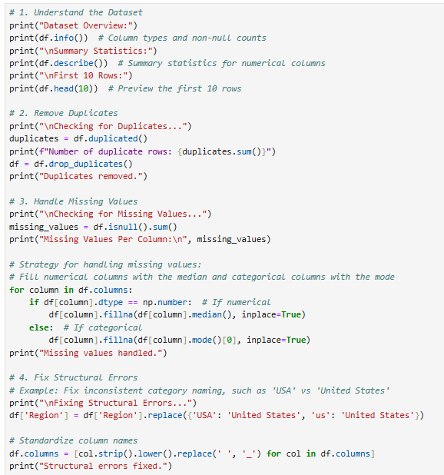
Data cleaning
Understand the Dataset
Remove Duplicate
Handle Missing Value
Fix Structural Errors
Correct Data Type
Normalize and Scale Data

Slide 12
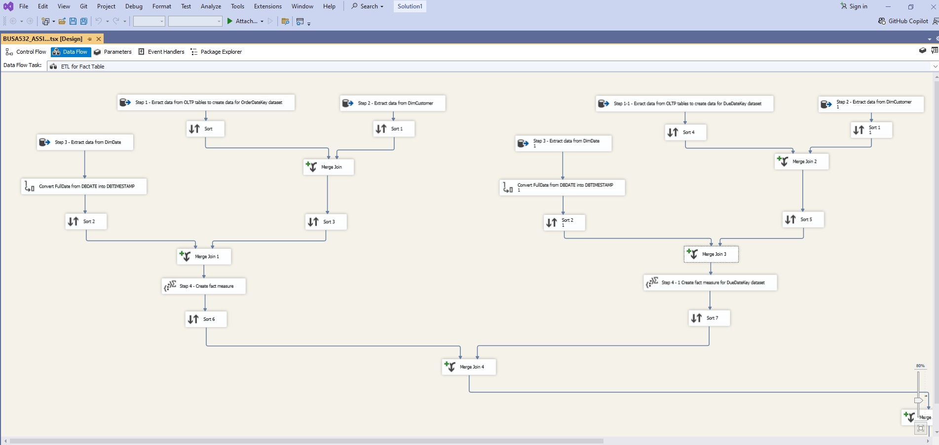
Inserting data to SSIS (SQL Server Integration Services)

Slide 13
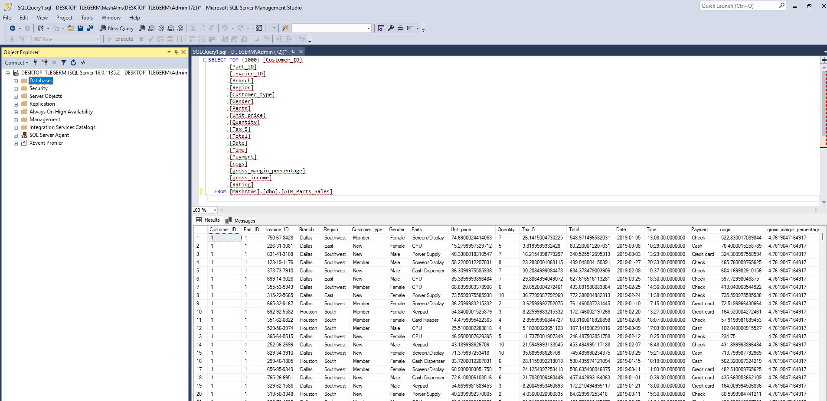
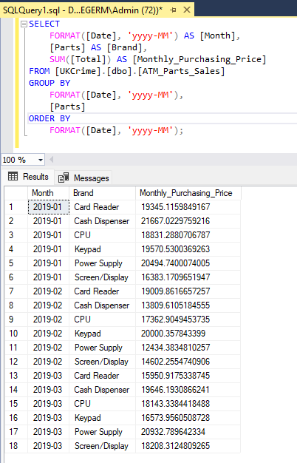
Inserting data to SSms (SQL Server Management Studio)

Slide 14
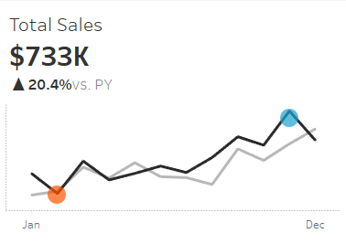
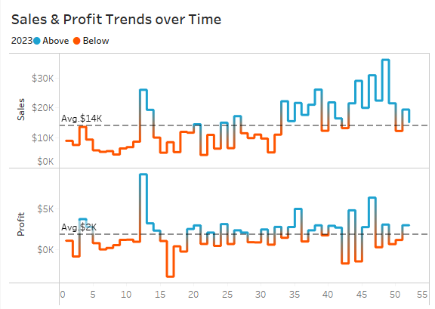
With tableau
Data visualization

Slide 15
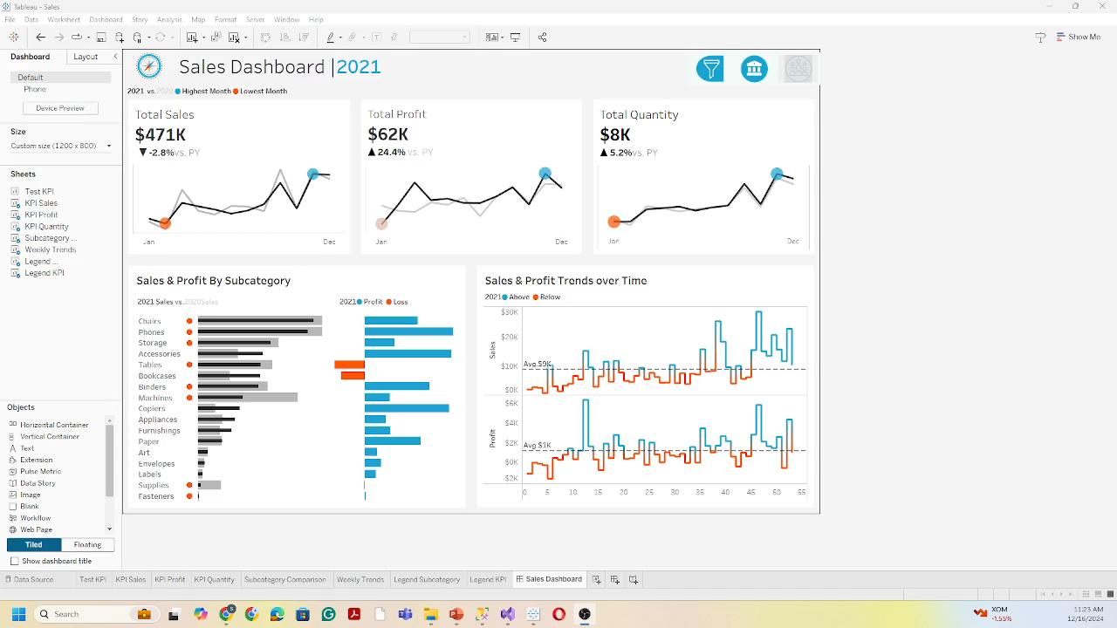

Slide 16
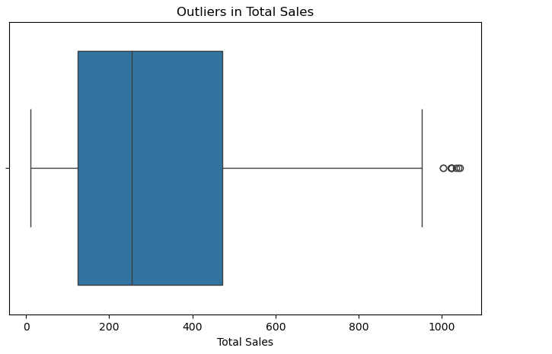
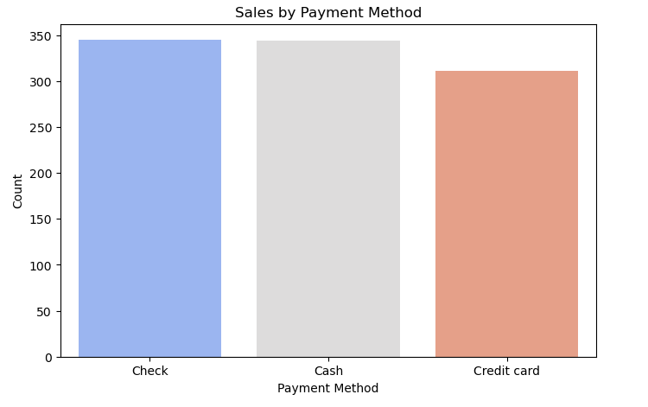
Data visualization
With tableau

Slide 17
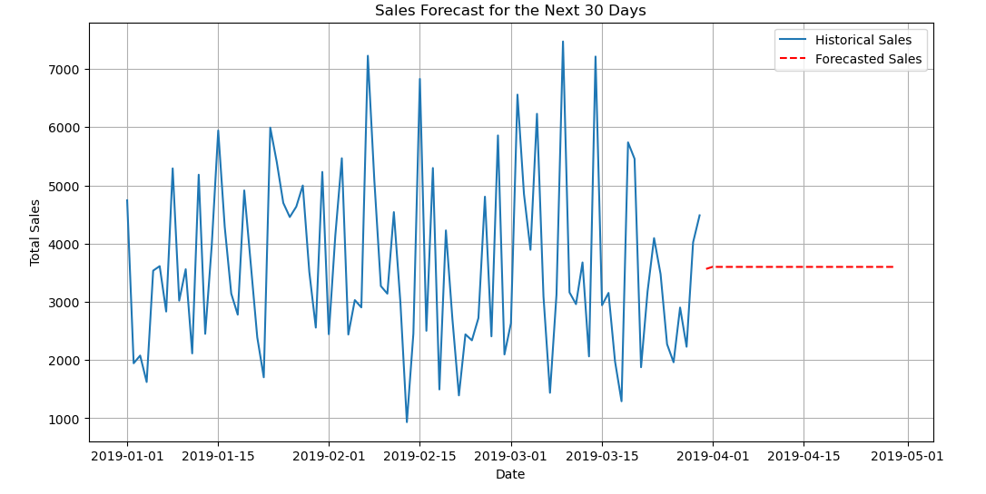
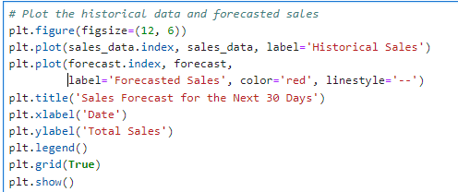
Data visualization
With tableau

Slide 18
Strategic Insights and Actionable Recommendations

Slide 19
Data-Driven Inferences and Conclusions
High-Performing ATMs
Consistent sales growth observed in key parts and regions over 5 years.
Outliers in Sales Data
Unusually high transactions require further analysis for demand and inventory optimization.
Trends Over Time
Sales peak during Q2 and Q4 due to seasonal trends.
Customer Insights
Loyal customers drive 70% of sales, emphasizing retention strategies.
Optimization Opportunities
Improve part availability in high-demand regions to reduce downtime and boost satisfaction.

Slide 20


Q & A

Slide 21
FINAL TIPS & takeaway
Focus on Key Products
Prioritize inventory for high-revenue parts like cash dispensers and cassettes.
Address Outliers
Investigate unusual sales transactions to optimize demand forecasting.
Leverage Seasonal Trends
Align marketing and stock availability with peak quarters (Q2 & Q4).
Retain Loyal Customers
Strengthen retention strategies to maintain the 70% contribution from loyal customers.
Optimize Availability
Reduce downtime by improving part availability in high-demand regions.

Slide 22
THANK YOU
Cansu Borak
469-785-9070
cansugborak@gmail.com
https://cansuborak.github.io/

